Slide 1

DATA WAREHOUSING AND BUSINESS INTELLIGENCE FOR A VIDEO-GAME MARKETING CONSULTANCY
GROUP-B
Student Names
Guided by:
Prof. Dr. Joseph Morabito

Slide 2

Marketing Intelligence Consultancy Services (MICS)
Marketing Intelligence Consultancy Services (MICS) is a specialized company focused on helping video game sector clients create higher selling products through industry leading business intelligence, data analysis, product accessibility assessment and games industry specific management consulting services.
The mission of MICS is to empower individuals and teams in the video game industry to create outstanding products and business results.
You have questions. You have data. MICS will guide you through how to get the most out of your data so you get insightful, meaningful answers.
It is a highly complex metric composed of many qualitative, technological and creative factors both internal and external to the game itself that vary by genre, platform, brand and even release window. For example -
Forward looking Genre / Category analysis and competitive landscape overview of future game releases
Specific recommendations to increase accessibility (and thus sales)

Slide 3
Overview
Detailed Fact Table
Ticketing System - Snowflaking
Conformed Dimensions
Transformation Rules
Aggregate Table
Slicing & Dicing
Data Marts
Tableau Demo & Dashboards
References
Business Lifecycle Approach
Steps to Dimensional Modeling
Prioritization Grid
Opportunity Matrix
SWOT Analysis
High-Level Bus Matrix
Detailed Level Bus Matrix
Logical Fact Diagram
Star Schema
Dimension Attribute Detailed Description

Slide 4
Steps to Dimensional Modeling
1 | Select the Business Process | •A Business Process is chosen as a Fact Table •Design the DW by the Business Process not the Business Unit
2 | Declare and define Grain | •Represents one row of the Fact Table •Choose the lowest possible grain, aggregate to higher levels
3 | Identify the Dimensions | •Dimensions explain Fact tables •Represent Query Entry-Points into the Star Schema •Each Dimension has several Attributes
4 | Identify the Facts | •Facts are numeric fields that populate each fact table record •We have identified our fact table as a factless fact table

Slide 5

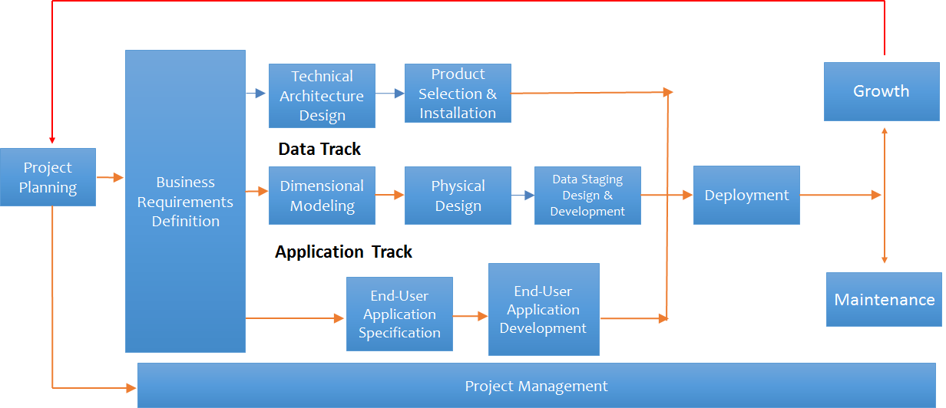

Slide 6
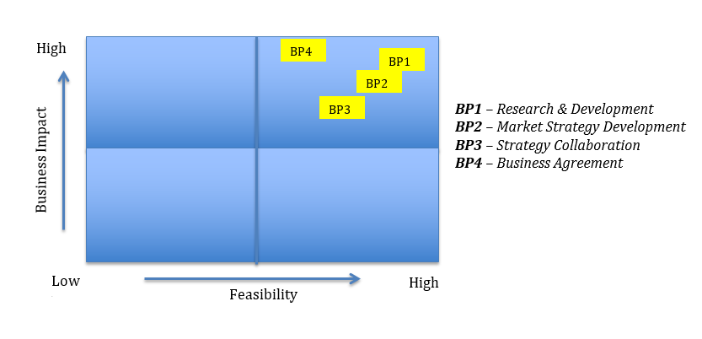
PRIORITIZATION GRID

Slide 7
OPPORTUNITY MATRIX
Business Process | Customer Service | Finance | Marketing | Strategy Management | Risk Management | Human Resource
Research & Development |  | X |  |  | X | X
Market Strategy Development |  | X | X | X | X | X
Strategy Collaboration | X | X | X | X | X | X
Business Agreement | X | X |  |  | X

Slide 8
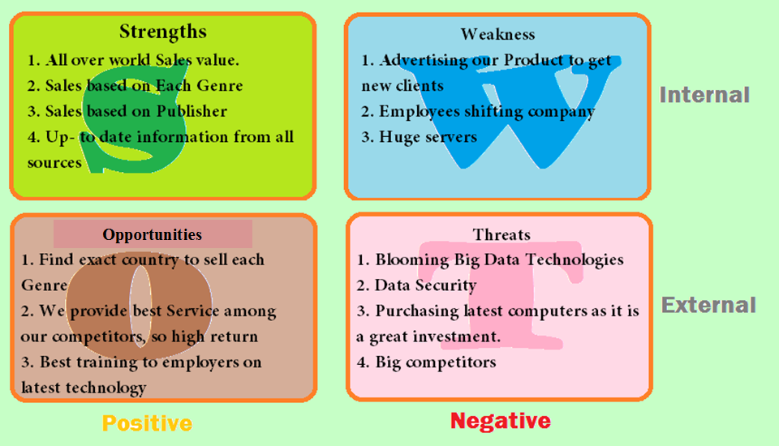
SWOT Analysis

Slide 9
HIGH-LEVEL BUS MATRIX
Business Process | Time | Publisher-Details | Platform-Details | Genre-Details | Video Game Details | Market Report | Employee
Research & Development | X | X | X | X | X |  | X
Market Strategy Development | X | X | X | X | X | X | X
Strategy Collaboration | X | X | X |  | X | X | X
Business Agreement | X |  |  |  | X | X | X

Slide 10
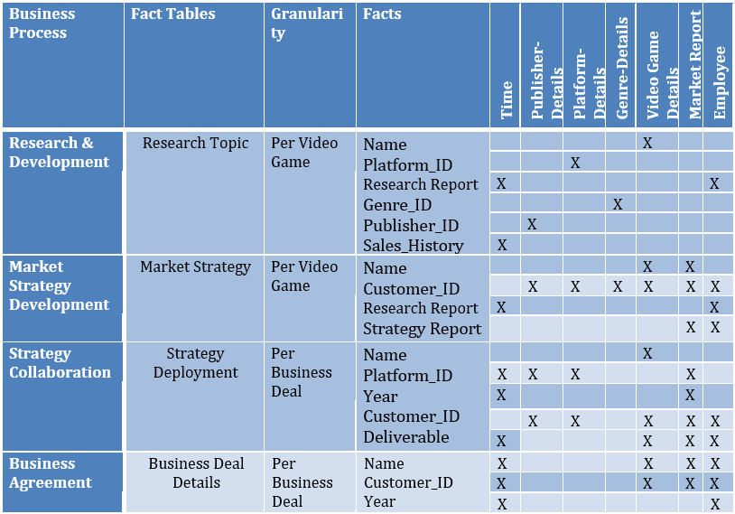
DETAILED LEVEL BUS MATRIX

Slide 11
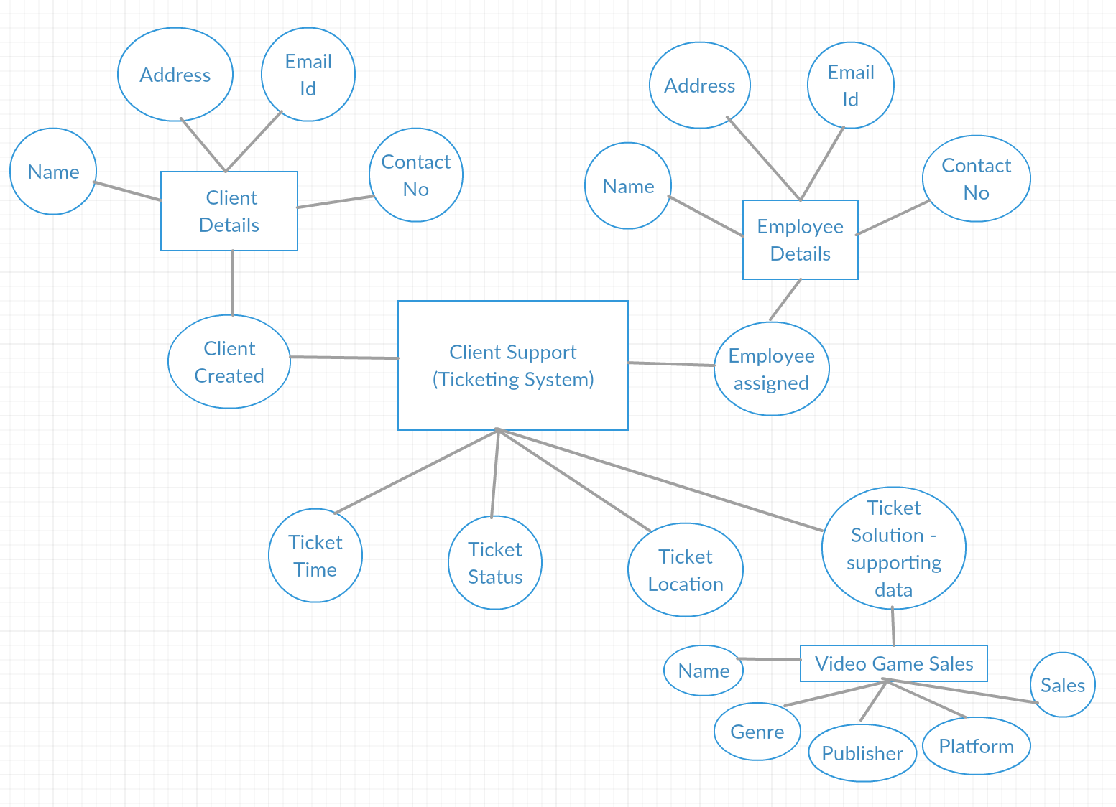
Logical Fact Diagram

Slide 12
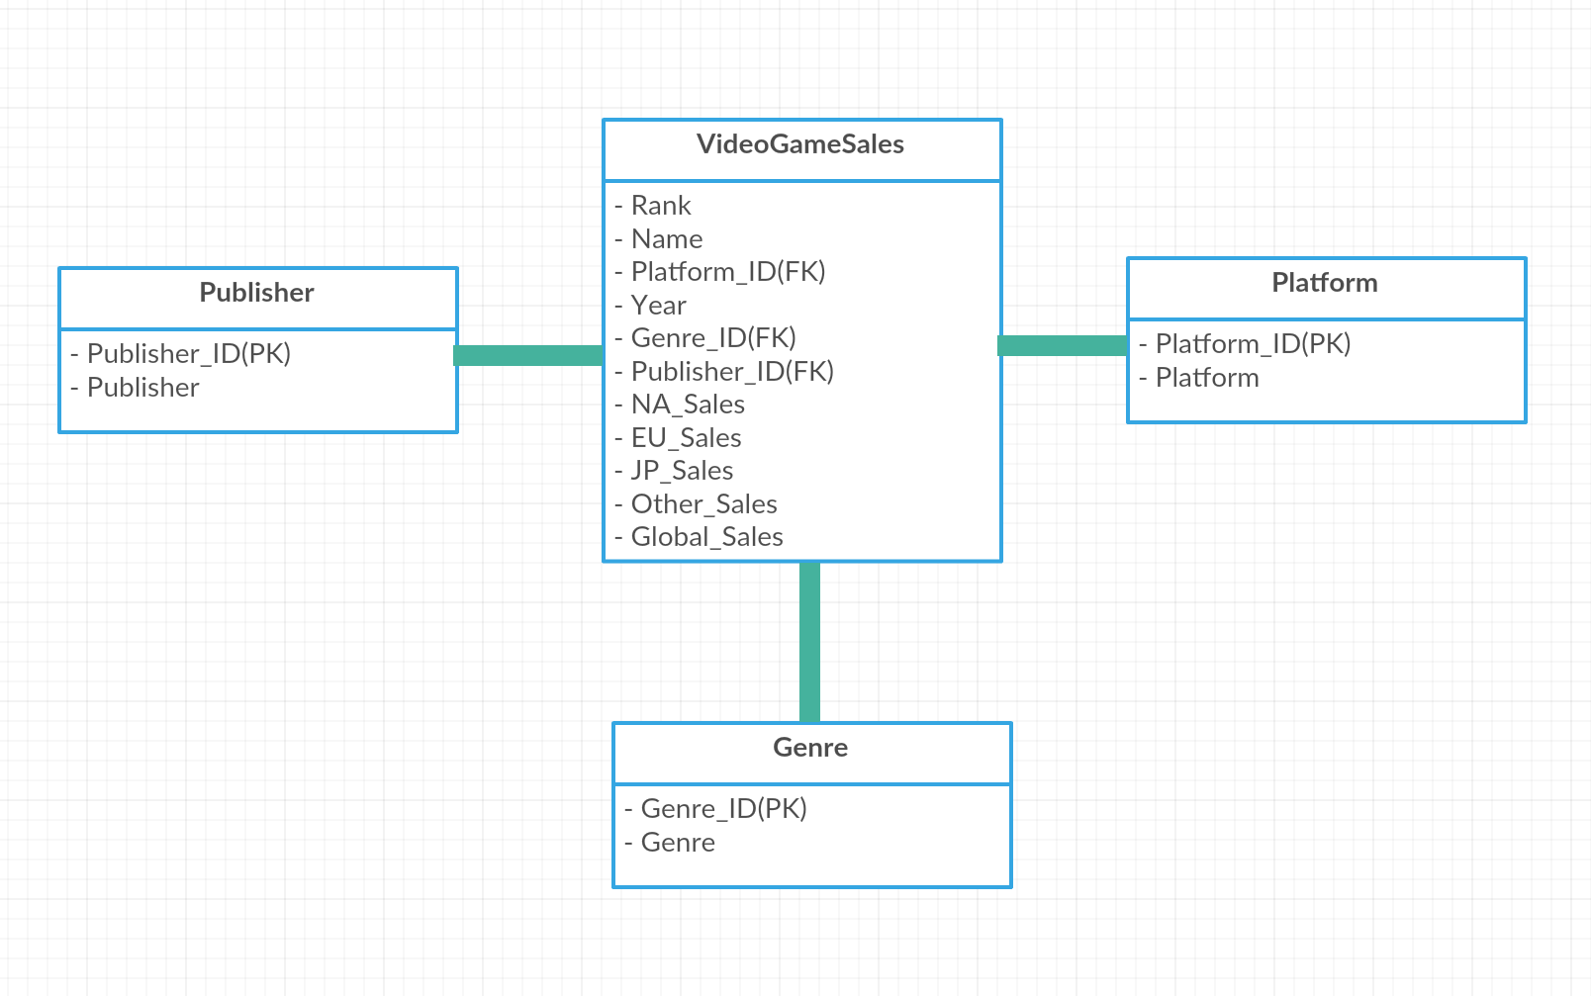
Star Schema - VideoGameSales

Slide 13
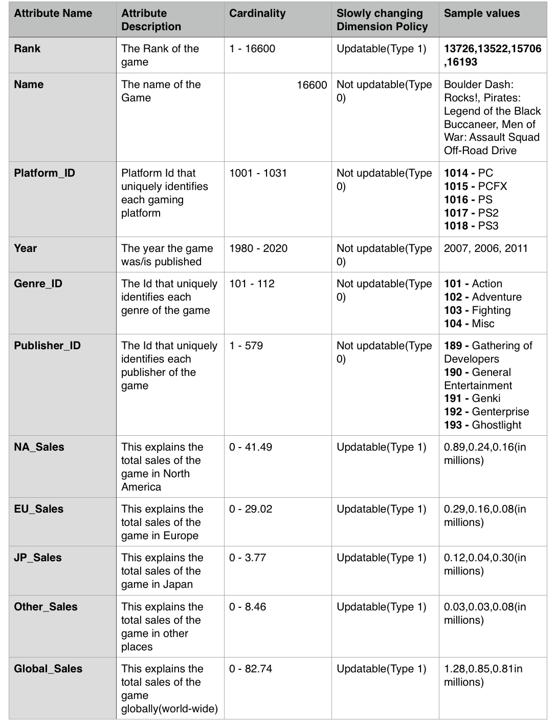
Dimension Attribute detailed description

Slide 14

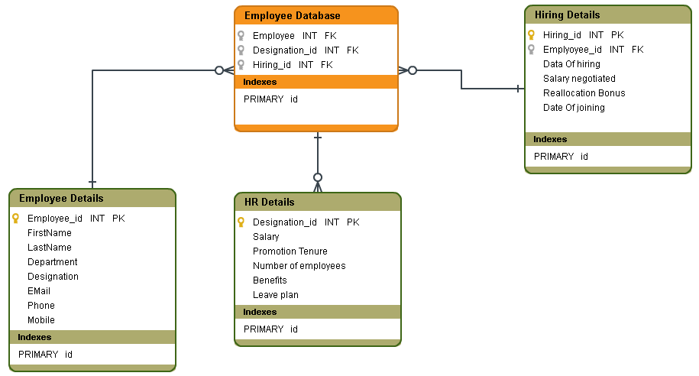


Slide 15
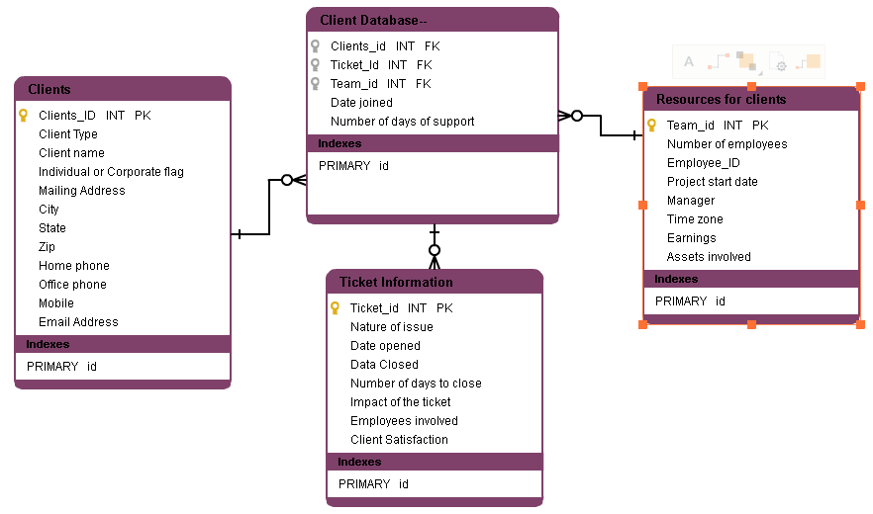
CLIENT STAR SCHEMA

Slide 16
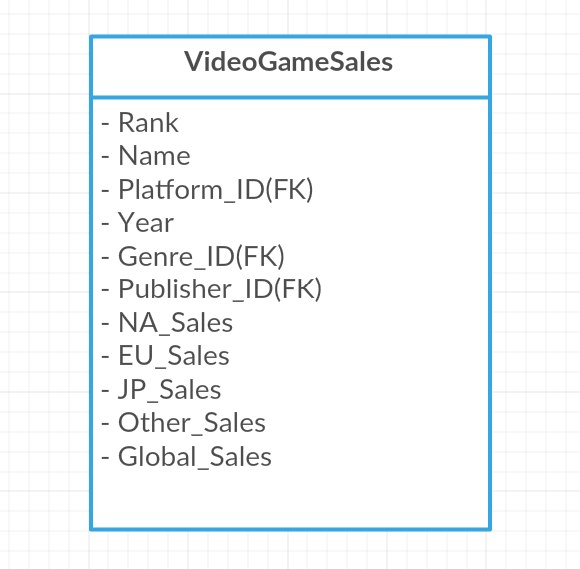
Fact Table Detail - Video Game Sales
Fact table detail diagram showing dimension keys, basic facts and derived facts.

Slide 17
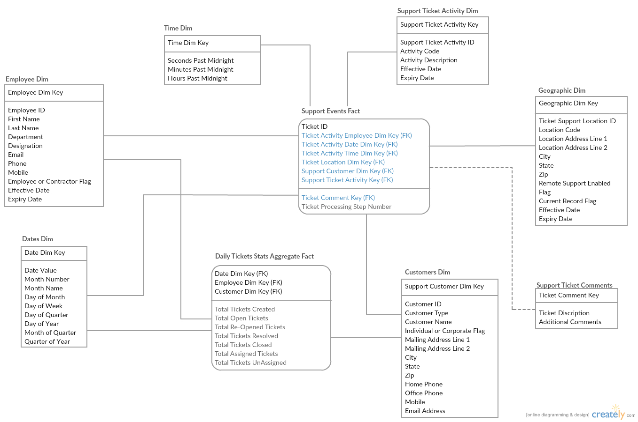
Ticketing System - Snowflake Schema

Slide 18
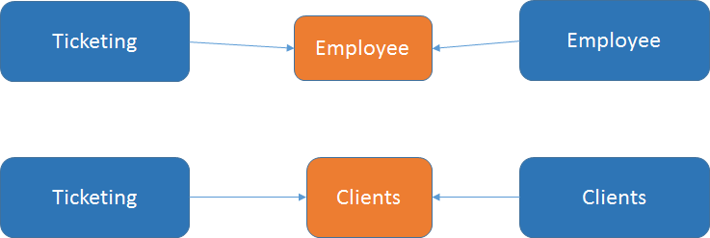
Conformed Dimensions
•A conformed dimension is a dimension that means the same thing with every possible fact table to which it can be joined. Table of employee commons between ticketing and employee fact tables, and table of client commonly used for both ticketing and client fact tables.

Slide 19
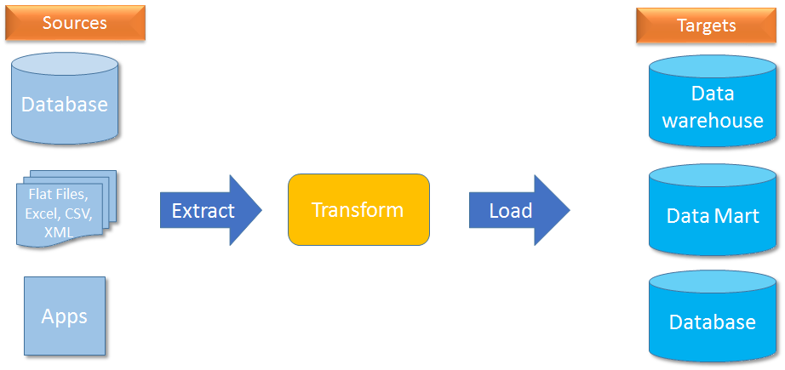
Transformation Rules
•Data transformation is the process of converting data from one format such as a database file, XML document, or Excel sheet to another.
Notes:
Because data often resides in different locations and formats across the enterprise, data transformation is necessary to ensure data from one application or database is intelligible to other applications and databases, a critical feature for applications integration.

Slide 20
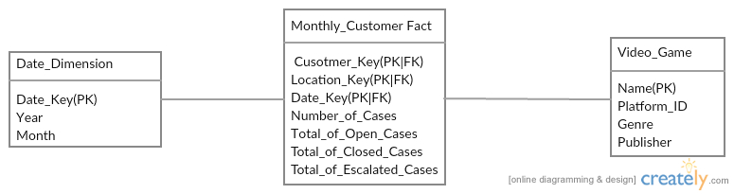
Aggregate Table

Slide 21
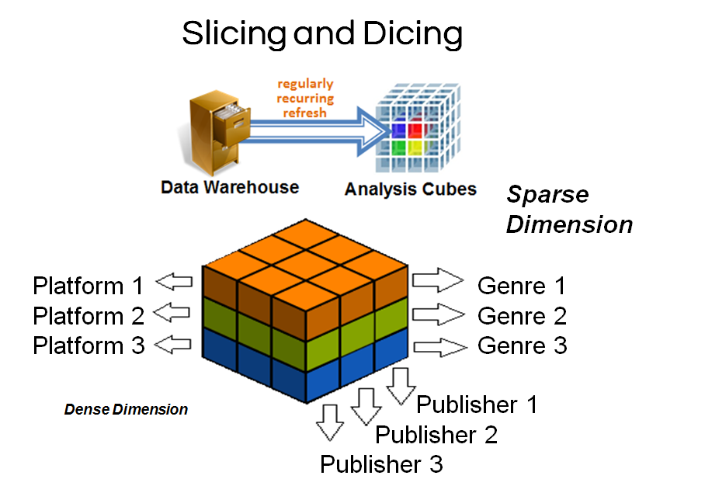

Slide 22
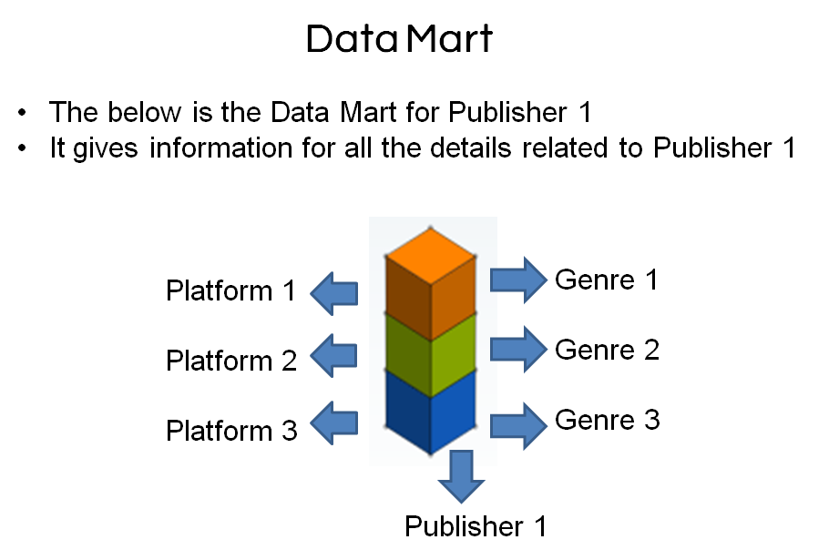


Slicing and Dicing
1. This slice can be used to see things particulary to Publisher 1
2. Queries can be fired to see data only related to Publisher 1 and its corresponding Genre and Platform sales

Slide 23
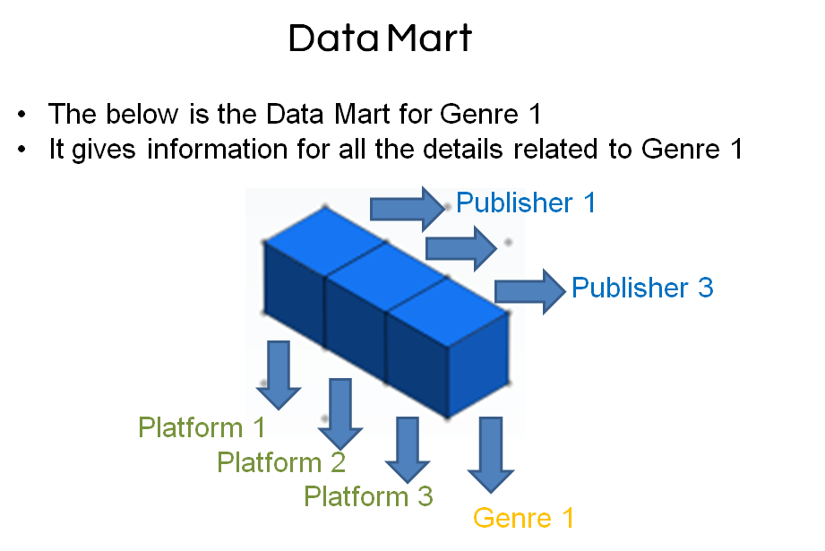
Slicing and Dicing
1. This slice can be used to see things particulary to Genre 1
2. Queries can be fired to see data only related to Genre 1 and its corresponding Publisher and Platform sales

Slide 24
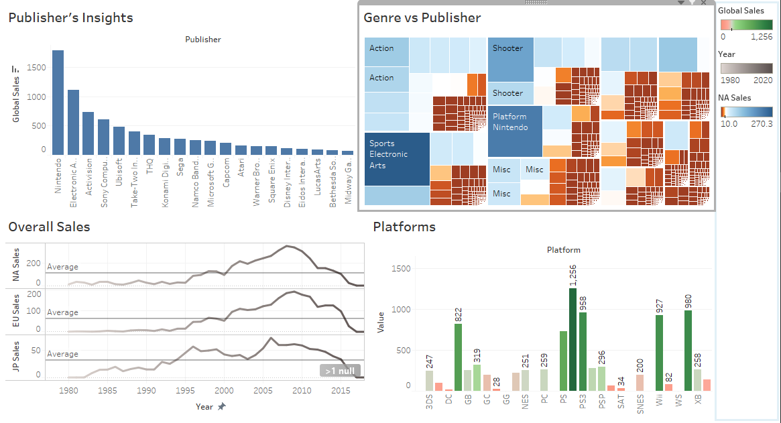
Dashboard-1

Slide 25
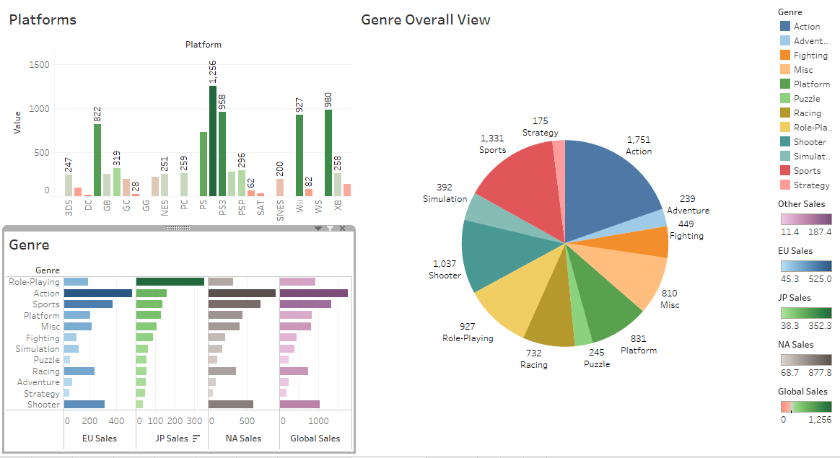
Dashboard-2

Slide 26
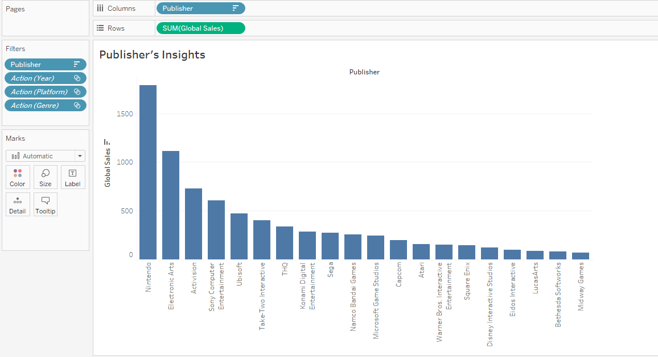
Publisher’s Insights

Slide 27
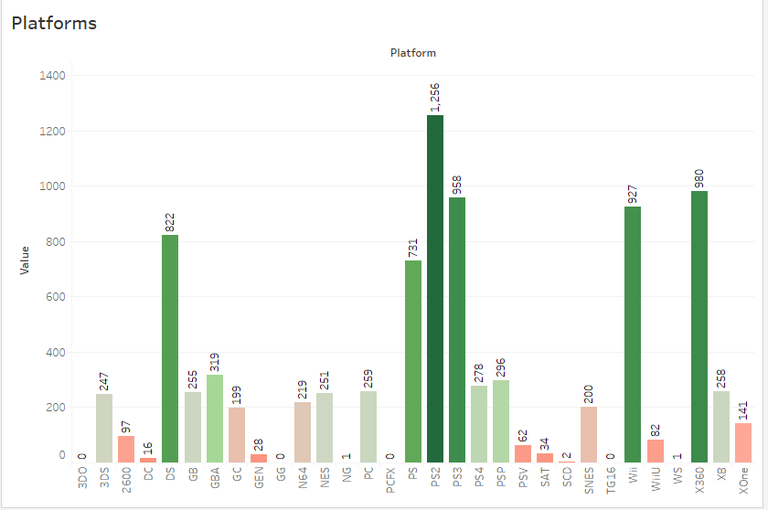
Platform Insights

Slide 28
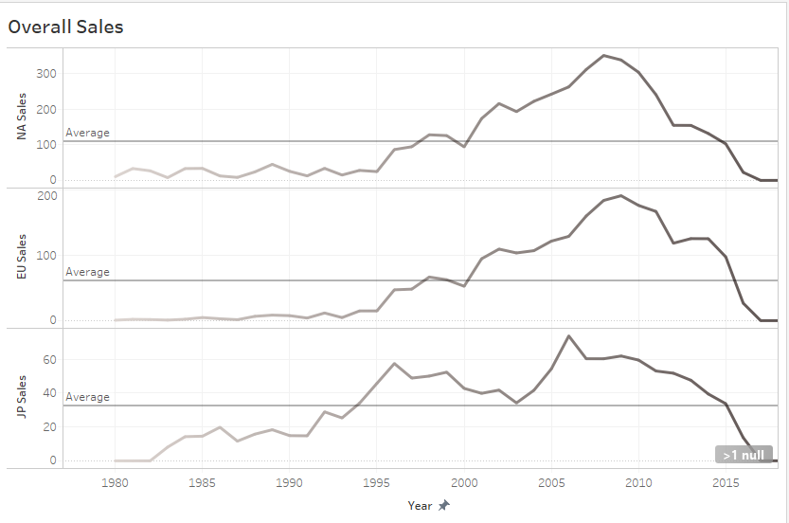
Overall Global Sales

Slide 29
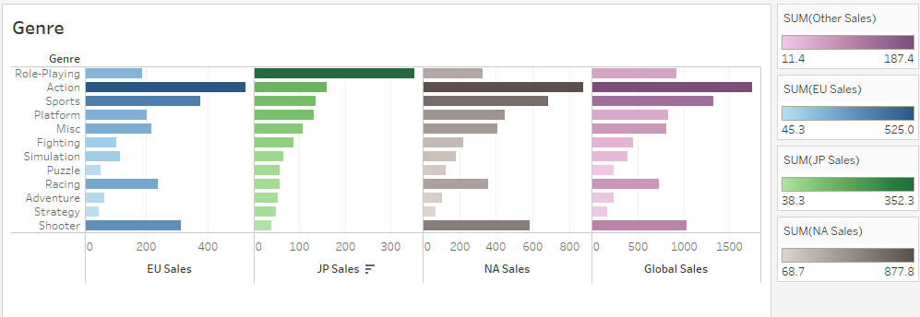
Combined Sheet for Genre

Slide 30
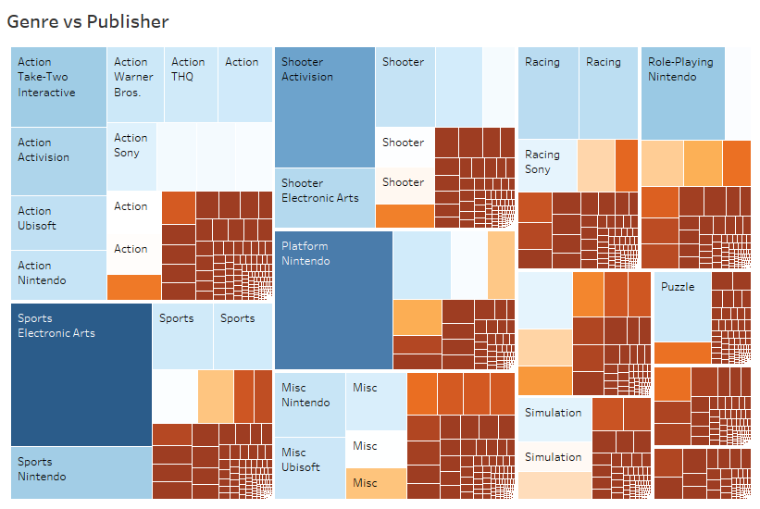
Tree Map of Genre vs Publisher

Slide 31
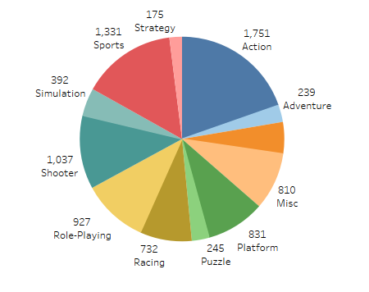
Genre overall view

Slide 32
Tableau Public
http://alturl.com/rh6ff

Slide 33


